Slide 1
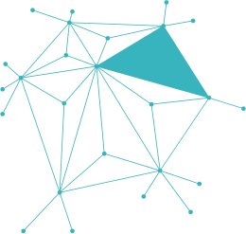
PHISHING AWARENESS TRAINING
Stay Smart, Stay Safe!

Slide 2

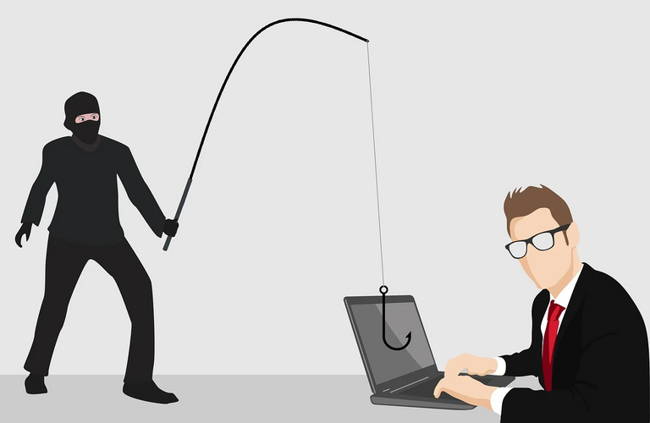
WHAT IS PHISHING?
DEFINITION:
Phishing is a cyber attack where attackers trick users into revealing personal or sensitive information by impersonating legitimate sources.

Slide 3
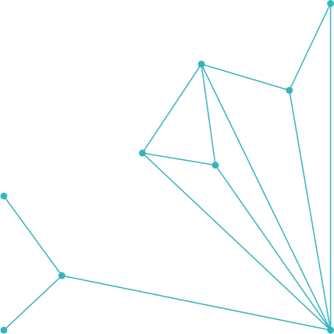
TYPES OF PHISHING ATTACKS
EMAIL PHISHING
SpEAR PHISHING (TARGETED ATTACKS)
SMISHING (SMS)
VISHING (VOICE CALLS)
CLONE PHISHING
BUSINESS EMAIL COMPROMISE (BEC)

Slide 4



HOW TO RECOGNIZE A PHISHING EMAIL
Generic greeting (“Dear Customer”)
Suspicious sender address (e.g. amaz0n@secure-account.com)
Urgency or threats (“Account will be locked in 24 hours!”)
Unexpected attachments or links
Spelling/grammar mistakes

Slide 5

PHISHING WEBSITE RED FLAGS
URL mismatch (e.g., www.faceb00k.com)
HTTP instead of HTTPS
Fake login pages
Poor design or logos

Slide 6

SOCIAL ENGINEERING TACTICS
Creating urgency or fear
Pretending to be someone in authority (boss, IT department)
Exploiting trust and curiosity
Baiting with rewards
Example: “Hey, it’s the CEO, please wire $5,000 urgently.”

Slide 7
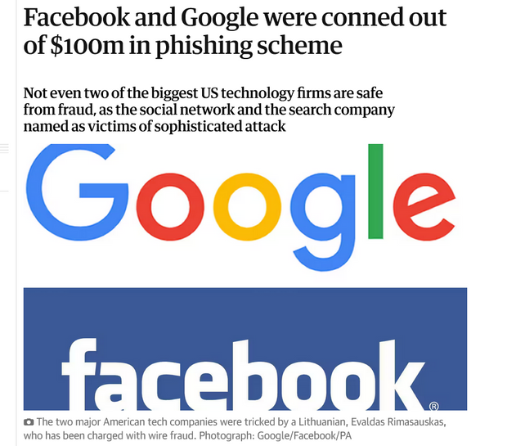
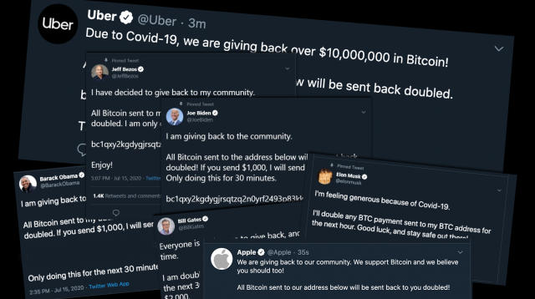
REAL-WORLD EXAMPLES
GOOGLE & FACEBOOK LOST $100M TO A PHISHING SCAM
TwitTER HACK (2020): ATTACKERS USED PHONE PHISHING TO ACCESS ADMIN TOOLS

Slide 8
HOW TO PROTECT YOURSELF
✔️ Verify the sender
✔️ Don’t click unknown links
✔️ Never share passwords or OTPs
✔️ Use multi-factor authentication (MFA)
✔️ Keep systems and browsers updated
✔️ Report suspicious messages to IT

Slide 9


PRICING
TABLE
Think before you click
Hover over links to preview URLs
Bookmark official websites
Educate your team and family
Use email filters and antivirus software

Slide 10






INTERACTIVE QUIZ
Question 1:
Which of the following is a phishing indicator?
A. Greeting by name
B. Urgent password reset request
C. Sent from your domain
Correct Answer: B
Question 2:
True or False: HTTPS always means a site is safe.
Correct Answer: False

